Slide 1
Memory
Input
Output
Processor
Control Unit
Arithmetic Logic Unit

Slide 2
A
C
D
B
Control Unit
ALU

Slide 3
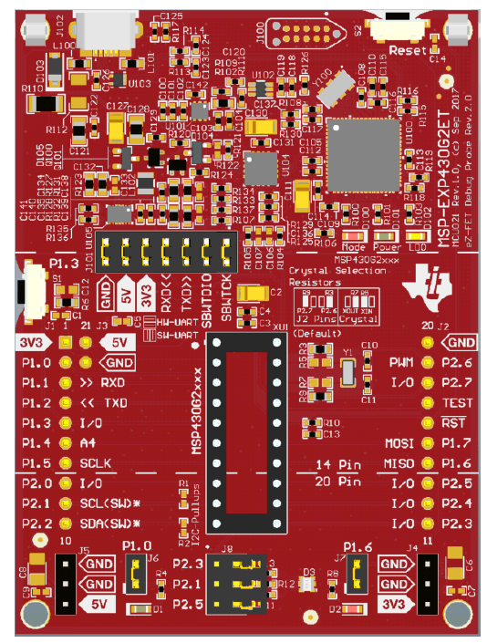
A
B

